Slide 1
WELCOME
THE SIMILARITIES & DIFFERENCES
IN BUSINESS CULTURE & OPPORTUNITIES
BETWEEN INDIA & USA
www.mentoronroad.com/usa
Mentor on Road USA interaction with
American businesses

Slide 2
www.globalnetworkindia.com
International trade advisory firm since 21 years
- Facilitating Exports, imports, joint ventures, technology
transfer and investment
Trade & Investment Representative of Government of Manitoba, Canada in India
Working with Government of Senegal, Sri Lanka & Brunei.
Working in Afghanistan since last 8 years on SMB projects.

Slide 3
www.clusterpulse.org
An ISO certified, not for profit, economic development agency since 14 years.
It is a professionally managed, self-sustaining, autonomous institution with excellence in implementation of Cluster Development initiatives for SMB’s as its main objective.
Working with SMB’s to improve their production processes, technology upgradation, HR best practices, access to sources of finance and international market access.
Worked in 102 clusters in 20 countries ( 80 locations in India )

Slide 4
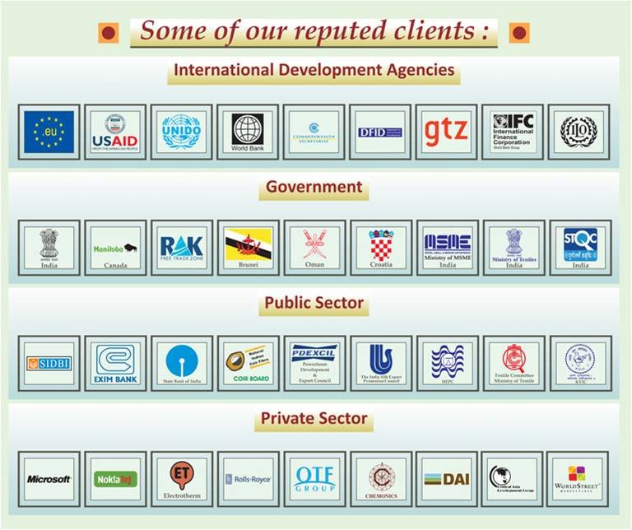

Slide 5
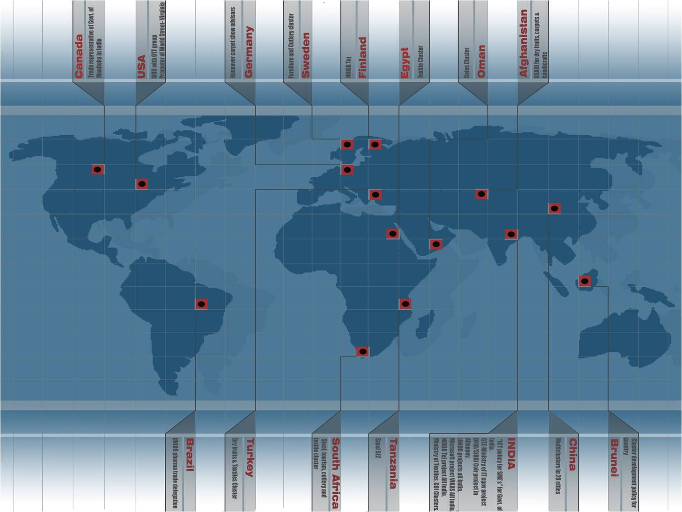
We have worked in projects in
20 countries

Slide 6
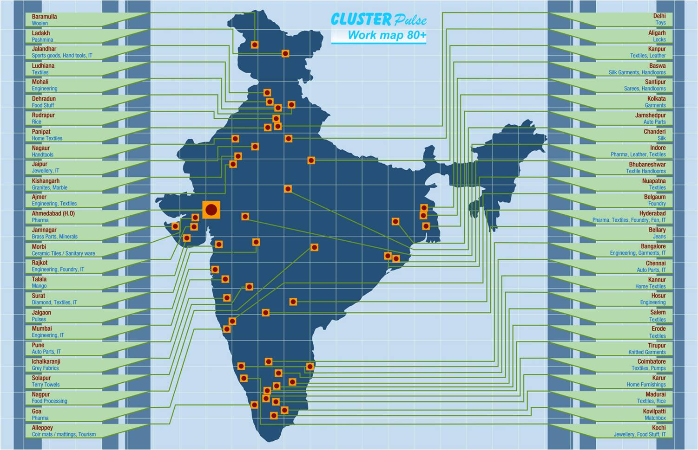
We have worked in 80 locations in India

Slide 7
PART OF INTERNATIONAL BODIES
Vice Chairman, United States – India Importers Council ( USIIC ) : www.usiic.in
Mentor on road USA has been organised with support of US Commercial Services ( USCS ), Start up India, Ministry of Commerce – Government of India and USIIC.

Slide 8
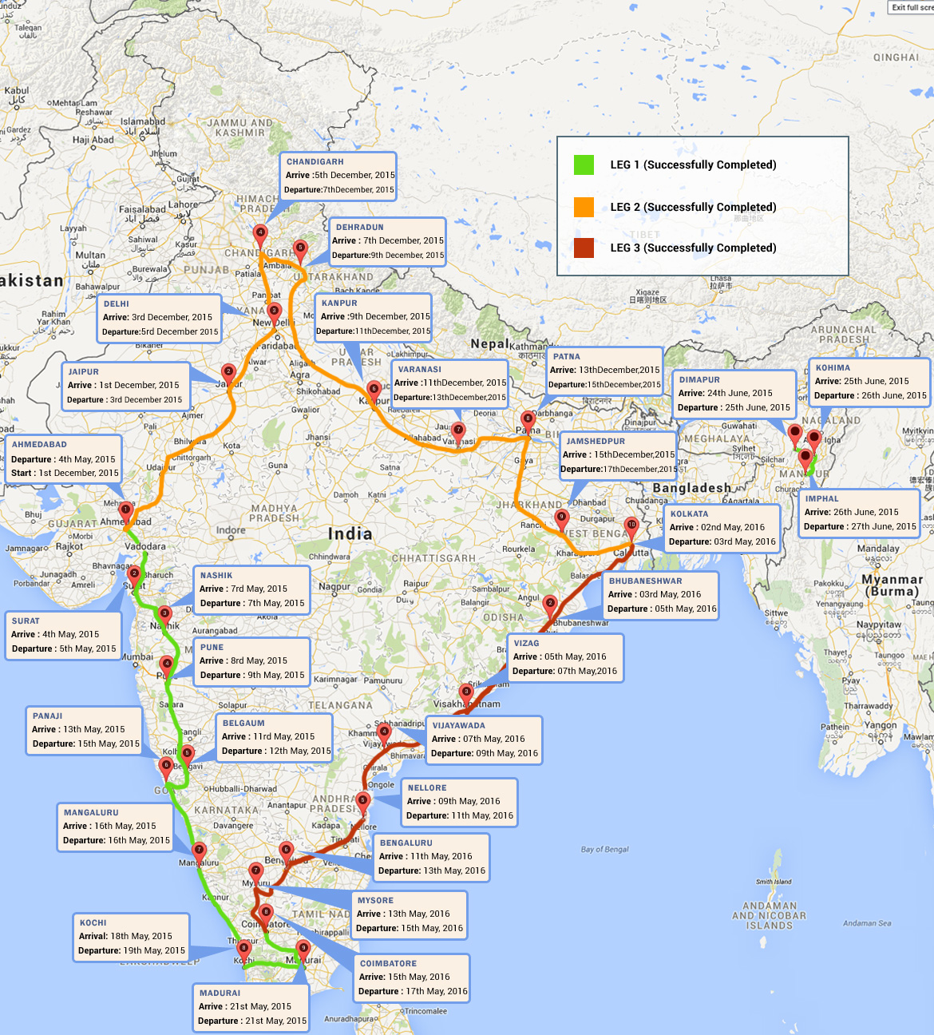

Slide 9
Meeting Start ups, SMB’s, Women owned businesses,
UN WOMEN, Corporate CSR, and Indian Diaspora - 115
Bottom line – 100 Success stories ( State mentors )

Slide 12
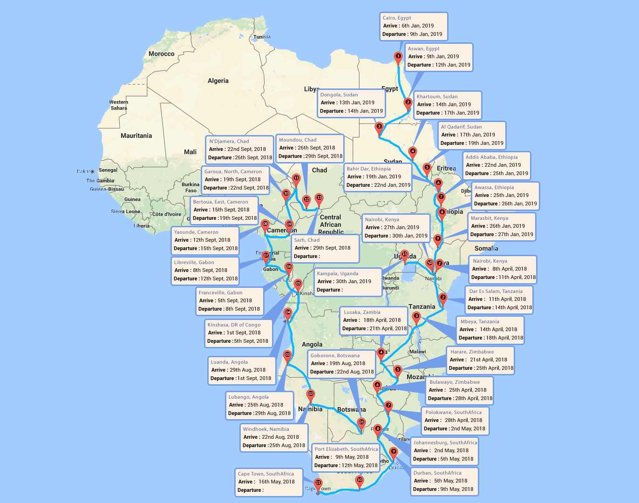
Africa from 11 April 2018
16 Countries, 34 cities, 110 days, 13045 miles, 21075 kms

Slide 14
/VILLAGES
/Villages
1.5 Mn USD

Slide 15
SMART CITIES/VILLAGES
23 Mn vehicles produced in 2016

Slide 16
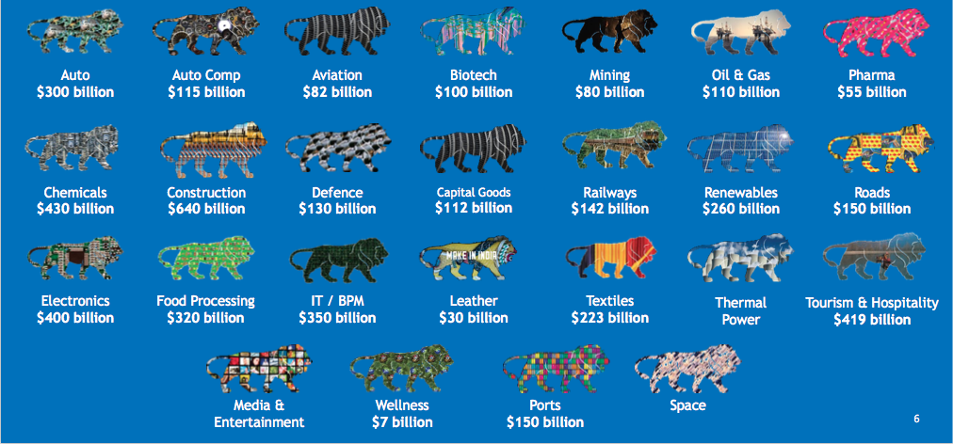
INDIA’S HIGHGROWTH SECTORS

Slide 17
Manufactured goods/industrial products/existing exporters
www.processbaron.com
www.amerex-fire.com
www.greensolarmanufacturing.com
www.schwarze.com
www.mcwane.com (manufacturing and engineering center in India)
www.mcwaneglobal.com
www.quicktrickalignment.com
Medical/Biotech
www.biohorizons.com
www.acclinategenetics.com
Engineering/Software
www.essanova.com
Other Representatives Attending
Safety equipment export/import (1)
Transportation and logistics companies (3)
Spices import (2)
University study abroad (1)
Non-profit community organizations (2)
Real estate associations (2)
Local organization for inward investment attraction to USA (1)

Slide 18
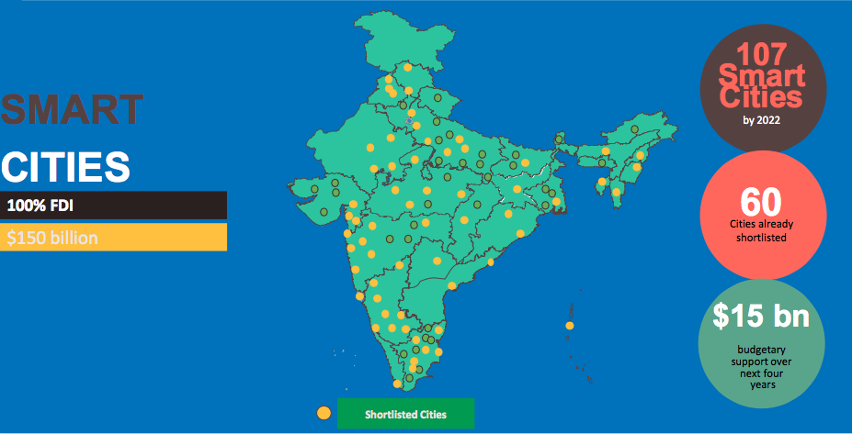
Smart Cities

Slide 19
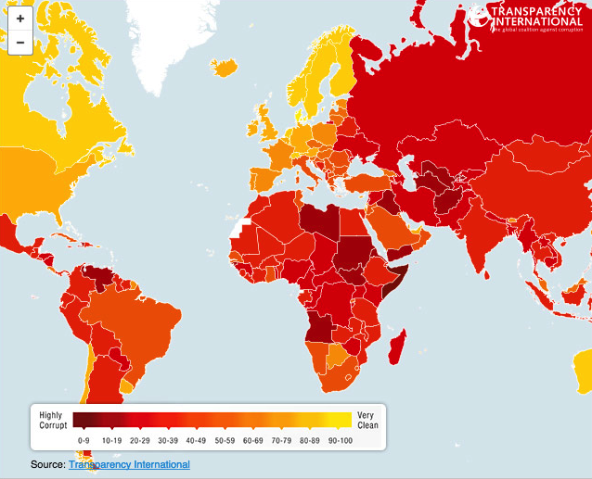
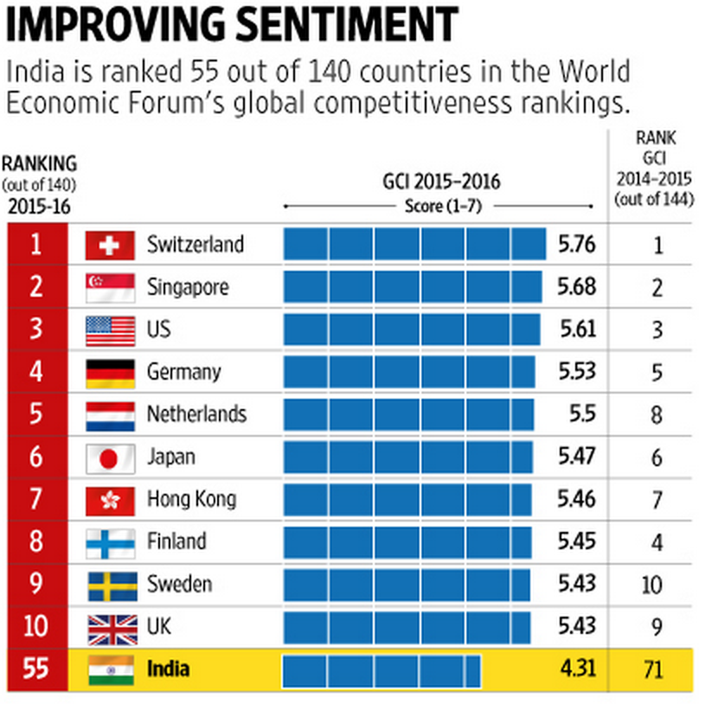
Some Digital India steps as opportunities for US biz
Ease Of Doing Business
- From142 to 130 out of 189
- Transparency International
The Competitiveness rankings show India
Ranked 55 out of 140 countries –
an improvement over 71 out of 144, two years
back
Digital India
- Jan Dhan accounts
- Electronic scrutiny of Income Tax
- 90% of the electronic returns have been
processed within 90 days.
- 80% of the IT refunds issued in 30 days.

Slide 20
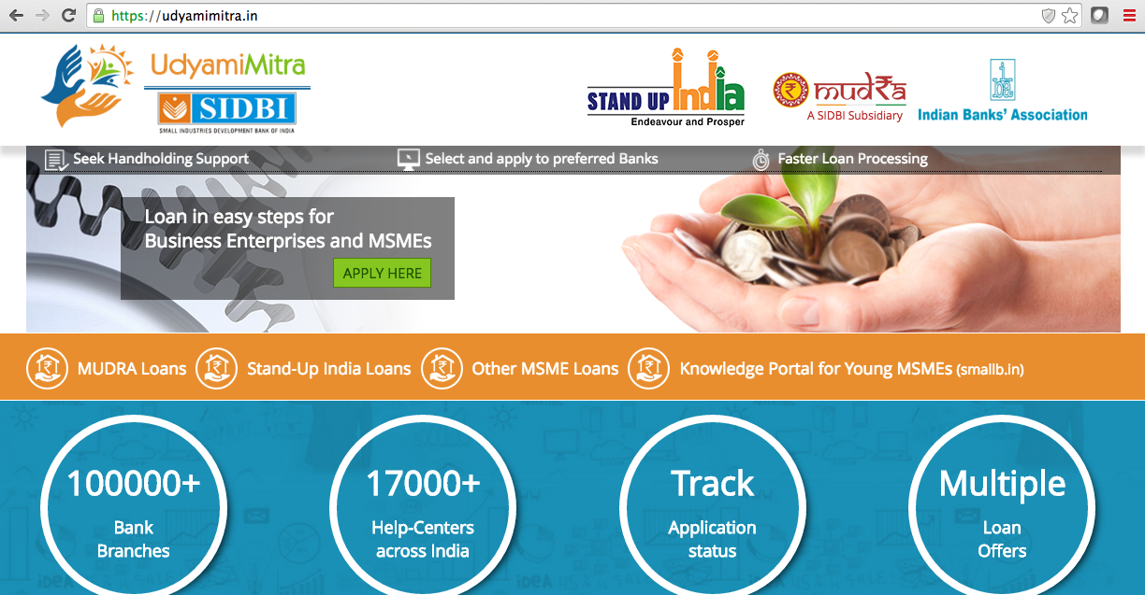
www.udyamimitra.in

Slide 21
MUDRA Bank www.mudra.org.in
Funding of the unfunded :
Missing Middle
PM Mudra Yojana coverage has crossed 3 crore ( 30 million ) accounts!
3.20 crore ( 32 million ) people given loans to pursue entrepreneurial ambitions!
RS. 1.41 lakh crores ( US$ 20 billion ) disbursed

Slide 22
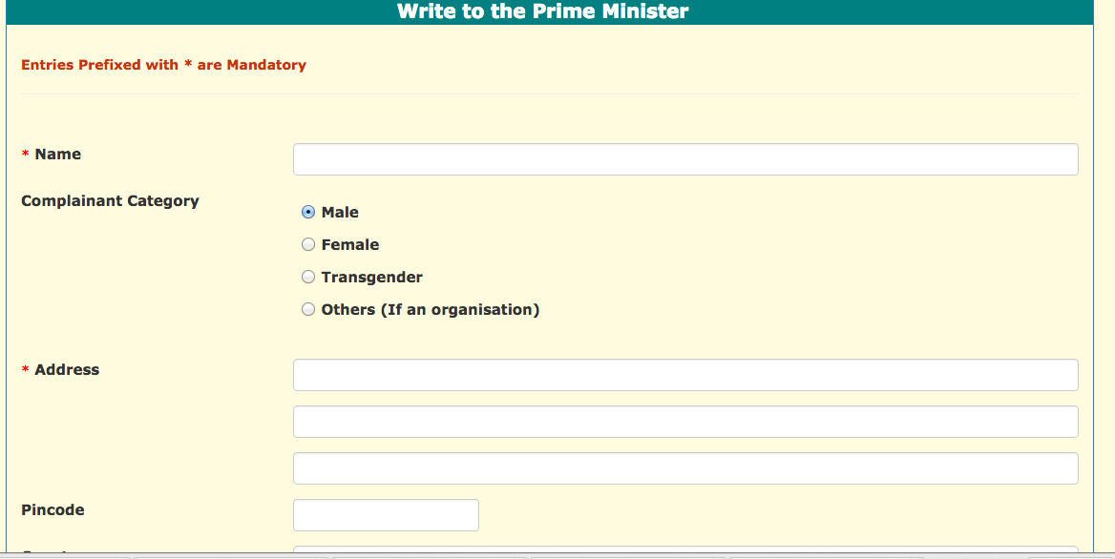
PMO grievance redressal system
http://pgportal.gov.in/pmocitizen/Grievancepmo.aspx

Slide 23
How to export products and services to India
Understanding Indian business culture
Franchising approach
Selling to Government
Distribution and sales channels – Trade shows
E Commerce approach

Slide 24
How To Export To India?
Strategic planning, due diligence, consistent follow-up, and perhaps most importantly, patience and commitment are all prerequisites to successful business in India.
This market necessitates multiple marketing efforts that address differing regional opportunities, standards, languages, cultural differences, and levels of economic development.
Gaining access to India's markets requires careful analysis of state wise consumer preferences, existing sales channels, and changes in distribution and marketing practices, all of which are continually evolving.
These issues are best addressed through and with an Indian partner or REP. Relationships and personal meetings with potential REPS are extremely important.
At first glance, the bulk of the purchasing power in India would appear to be concentrated in its urban markets. → However, a majority of the Indian population lives in rural areas distributed over some 638,000 villages. The balance lives in 7,935 towns of which approximately 468 have a population of more than 100,000 inhabitants.

Slide 25
How To Export To India - Franchising
India remains a “sizzling” market place for American franchisors.
Demand for U.S. brands remains strong in: food and beverage, hospitality, retail, education, garments and apparel, healthcare, fitness and personal grooming clinics.
India is also witnessing a consumption boom fueled by a huge demographic transformation.
This has led to a population of over 250 million middle-income Indians with high disposable incomes, changing lifestyles, mounting aspirations, appetite for Western goods, international exposure, options for quality retail space, and greater product choice and availability. The greater demand for goods in India is in turn generating a greater demand for U.S. franchises.
According to a recent KPMG and Franchise Association of India (FAI) report, the Indian franchise industry has a potential to grow to $51 billion in 2018 from the present 13.4 billion. The franchise industry is expected to contribute almost 4% of India’s GDP.
The United States is a key player in India’s franchise boom.

Slide 26
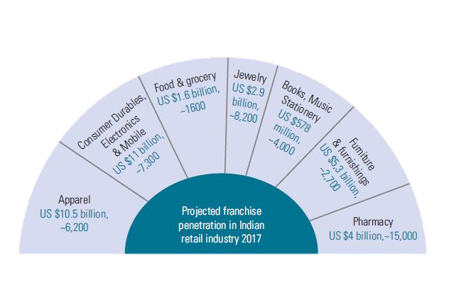
How To Export To India - Franchising
Projected State of Retail Franchising Industry in India by 2017
Figures indicate franchising revenues and franchisee outlets respectively
Source: Franchise Association of India (FAI)

Slide 27
How To Export To India – Selling to Govt.
Estimated size of the yearly government procurement market at the central government level in India is about $300 billion. Indian government procurement practices and procedures often lack transparency and standardization, which can frustrate foreign suppliers.
It is not unusual for negotiations to drag on for months and be held up at more than one level within the Indian bureaucracy for long periods with no discernible movement or reason given for lack of progress.
With this in mind, some firms seek out local representatives who are familiar with the culture and customs of India and are familiar with ways to expedite their product or service through the maze of bureaucracy in government ministries.
When foreign financing is involved, principal government procurement agencies tend to follow multilateral development bank requirements for international tenders.
The Government of India regularly advertises its requirements for the purchase of supplies and new equipment.
The competent authority invites tenders with a view to purchase goods and services. Suppliers, including foreign companies, willing to compete, may submit tenders agreeing to supply goods of the requested specifications.

Slide 28
How To Export To India – Distribution and Sales Channels
There has been a significant expansion in distribution channels in India during the past few years. → The Indian retail market, currently estimated at $ 490 billion, is projected to grow at a compounded annual growth rate of 6% to reach $865 billion by 2023. The total number of retail distribution outlets across India is estimated at over 12 million, mostly family owned businesses.
An annual growth rate for the fast moving consumer goods (FMCG) sector is predicted at 10-12% during the next 10 years. A firm can deliver its products to the user through a variety of channels, using a range of marketing intermediaries.
The three-tier system: Most Indian manufacturers use a three-tier selling and distribution structure that has evolved over the years. → This structure involves redistribution stockists, wholesalers, and retailers.
E.g. An FMCG company operating on an all-India basis will have between 40 and 80 redistribution stockists (RS). The RS will sell the product to between 100 and 450 wholesalers. Finally, both the RS and wholesalers will service between 250,000-750,000 retailers throughout the country. The RS will sell to both large and small retailers in the cities as well as interior parts of India.
Depending on how a company chooses to manage and supervise these relations, its sales staff may vary from 75 to 500 employees. Wholesaling is profitable by maintaining low costs with high turnover, with typical FMCG product margins anywhere from 4-5 %.

Slide 29
How To Export To India – eCommerce
eCommerce is India’s fastest growing and most exciting channel for commercial transactions. → Indian ecommerce is growing at an annual rate of 51%, the highest in the world, and is expected to jump from $30 billion in 2016 to $120 billion in 2020. (Source: ASSOCHAM-Forrester study paper.)
The retail sector is also showing a promising trend of 11% CAGR and is expected to reach $1 trillion by 2020.
eCommerce has made it easier for top American brands to reach Indian customers, and has emerged as one of the fast-growing trade channels available for the cross-border trade of goods and services.
There is a growing appetite for American brands, particularly in the categories including lifestyle products, consumer electronics, clothing, footwear and accessories, health and beauty, household goods, art and collectibles, event tickets and online music.
eCommerce in India can be broadly categorized as: Domestic and Cross-Border, B2B and B2C, Marketplace and Inventory based, and lastly single brand and multi brand. → Technology enabled innovations such as Digital Payments, Hyper-local Logistics, Analytics driven Customer Engagement and Digital Advertisements have enabled the ecommerce industry in India to grow at a much faster rate.
Government initiatives such as Digital India, Skill India and Start up India are also contributing to the growth of the ecommerce industry.

Slide 30
Sell online: www.bluenile.com

Slide 31
Sell online www.bestdressedkids.com

Slide 32
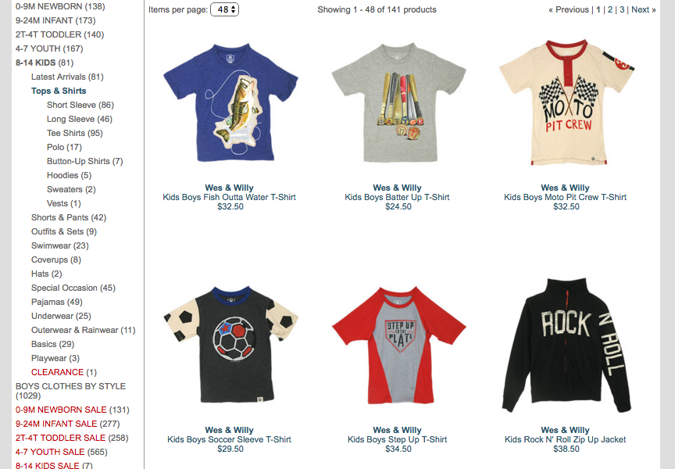
Sell online www.bestdressedkids.com

Slide 33
Sell online www.personalizeddoormats.com

Slide 34
Sell online www.personalizeddoormats.com

Slide 35
Sell online www.cypressindustries.com Autoparts

Slide 36
September 19 to 28, 2017
http://www.thegrinlabs.com/chinaindiamission/

Slide 37
How To Export To India – Web Sources
Commercial Service: http://export.gov/india/index.asp | American Chamber of Commerce, India: http://www.amchamindia.com/
U.S. India Business Council: http://www.usibc.com/ | Confederation of Indian Industry: http://www.cii.in/
Federation of Indian Chambers of Commerce and Industry: http://www.ficci.com/ | Indo-American Chamber of Commerce: http://www.iaccindia.com/
The Associated Chamber of Commerce & Industry (ASSOCHAM): http://www.assocham.org/ | U.S.-India Importers’ Council (USIIC): http://www.usiic.in/
U.S.-India Investors Forum (USIIF): http://www.usiif.in | The Franchising Association of India, www.fai.co.in
Ministry of Commerce http://commerce.nic.in/ | Retailers Association of India http://www.rai.net.in/
Indian Direct Selling Association http://www.idsa.co.in/ | India Brand Equity Foundation http://ibef.org/home.aspx
Reserve Bank of India: http://www.rbi.org.in/ | Government of India Directory: http://goidirectory.nic.in/
Government of India Ministry of Finance: http://finmin.nic.in/ | Government of India Ministry of Commerce and Industry: http://commerce.nic.in/
Government of India Department of Industrial Policy & Promotion (DIPP): http://dipp.gov.in/English/default.aspx# | Government of India tenders: http://www.tender.gov.in
Foreign Exchange Management Act: https://www.rbi.org.in/scripts/fema.aspx | CRISIL online (similar to the Better Business Bureau in U.S.): http://crisil.com/index.jsp

Slide 38
10 One-Liner Strategies for your Business
1. CORPORATE CULTURE
Define your company’s personality.
2. STRATEGIC PLANNING
Not market share- grow with discipline.
3. COST CONTROL
Lower costs equal lower prices.
4. INNOVATION
Do one thing better than any one else
5. CUSTOMER SERVICE
The customer comes second, service comes first

Slide 39
10 One-Liner Strategies for your Business
6. HIRING
Hire for attitude, train for skills.
7. TRAINING
Get all thinking like they own the place
8. EMPLOYEE MORALE
Celebrate everything, embrace mistake.
9. MARKETING AND ADVERTISING
Break the routine rule of sales and sell.
10. LEADERSHIP
Never stop thinking like an entrepreneur !

Slide 40
7 Forms of Capital and India!
Representative Elements
Representative Examples
Cultural
Tangible Articulations
Norms
Mental Models
Architecture, Music, Language
Range of Acceptable Behaviors, emotional intelligence
Trust, Wealth Creation Attitudes, Long-Term Thinking
Human
Health and Population
Education and Training
Attitudes and Motivation
Nutrition, Medical & Mental Health
Primary & Secondary, Technical
Self-responsibility, action-orientation
Higher Forms
Knowledge
Qualitative, Quantitative Data
Frameworks and Concepts
Knowledge Generation
Statistics, Opinions, Records
Theories, Processes, Procedures
Universities, R&D, Market Learning
Institutional
“Good, Clean Governance”
Justice System
Connective Organizations
Transparency, No Hidden Costs
Property Protection, Predictable Regulations
Chambers of Commerce, Unions
Financial
Financial Systems
Private Wealth
Public Wealth
Banks, Stock Markets
Bank Deposits
Bank Reserves, Taxes, Duties, Macroeconomic Stability
Lower Forms
Man-Made
Transportation, Communication
Power
Water and Sewerage
Roads, Ports, Telephone Systems
Electric Grids, Generation Capacity
Pipelines, Pumping Stations
Natural Endowments
Environmental Issues
Raw Materials
Climate and Location
Conservation, Restoration
Agricultural, Mineral, Petroleum
Proximity to Markets
Note: Items in normal type reproduce the original Wolfensohn framework. Items in italics are additions recommended by Cluster Pulse experience.
Notes:
Items in normal type reproduce the original Wolfensohn framework. Items in italics are additions recommended by Cluster Pulse experience.

Slide 41
Time for QUESTIONS..…time permitting after Q&A, sectoral talk will follow

Slide 42
Our philosophy : Action @ Speed of thought Follow Mentor on road at: www.mentoronroad.com/usa Facebook page: globaljagat Twitter: globaljagat Linkedin: /in/clusterpulse Handphone : India - +91-9825506441 USA - +1 928 306 5335 jagat@globaljagat.com
Any questions

Slide 43
SECTORAL FOCUS

Slide 44
INFRASTRUCTURE
8

Slide 45
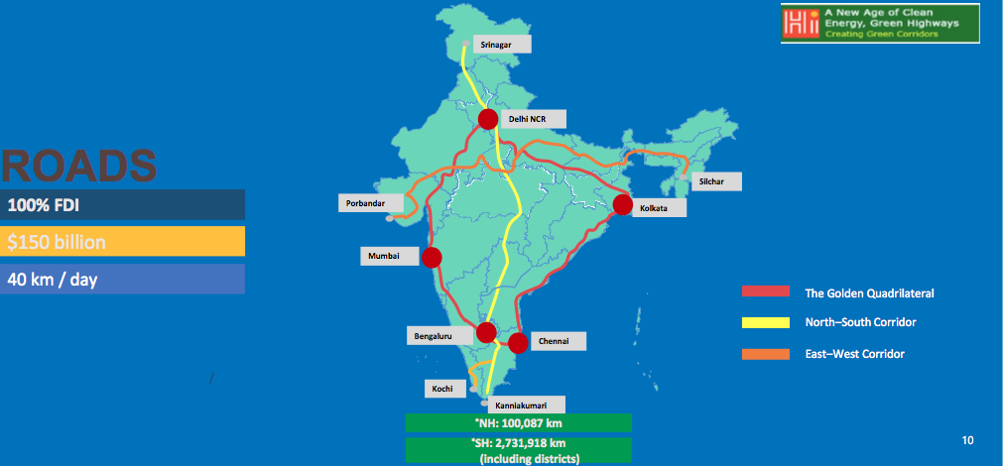
Roads and Highways

Slide 46
Railways: Dedicated Freight Corridors

Slide 47
Ports and Inland Waterways

Slide 48
CONSTRUCTION
RESIDENTIAL | Demand for more houses with growing nuclear families Organised sector growing faster than unorganised sector | HOSPITALITY | Business spending projected to go up from $19 billion in ‘15 to $41 billion by ‘26 and Leisure spending projected to go up from $93 billion in ‘15 to $208 billion by ’26
COMMERCIAL | The IT / ITES sector accounts for ~70% of office space Revival in the key western economies will translate into higher demand for office space | RETAIL | Opening up of single brand retailing to MNC retail chains Organized retail segment increased to more than 10% by ’16

Slide 49
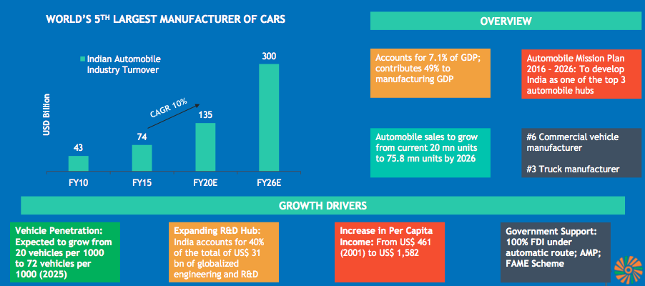
AUTOMOBILES

Slide 50
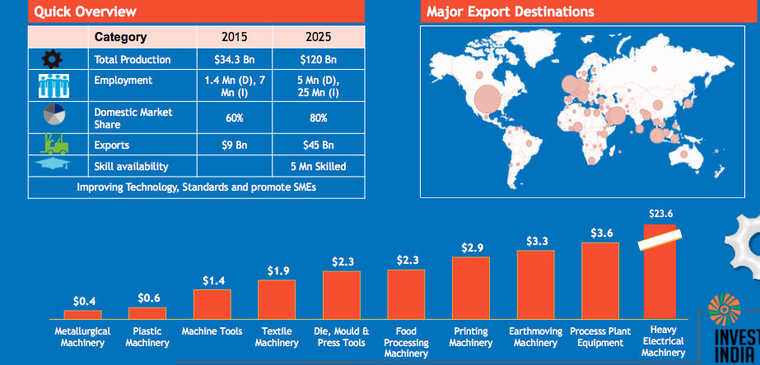
ELECTRICAL MACHINERY & CAPITAL GOODS
14 Mn (D),
7 Mn (I)

Slide 51
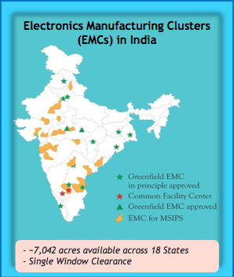
ELECTRONICS SYSTEM DESIGN & MANUFACTURING
5th LARGEST CONSUMER DURABLES MARKET IN THE WORLD BY 2025

Slide 52
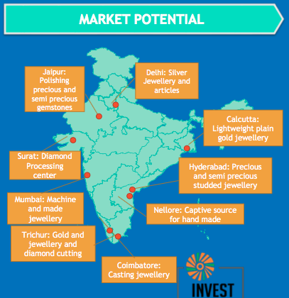
GEMS & JEWELERY

Slide 53
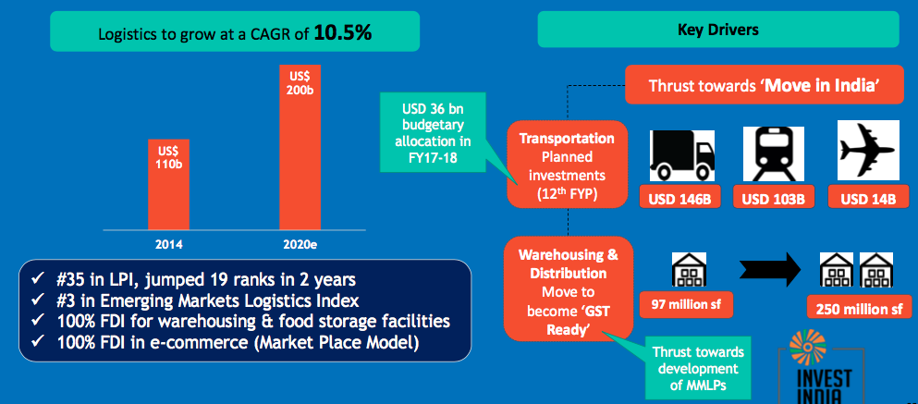
LOGISTICS AND WAREHOUSING

Slide 54
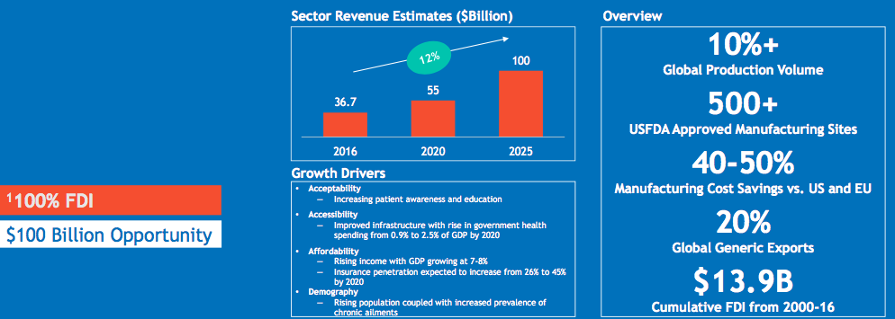
PHARMACEUTICALS

Slide 55
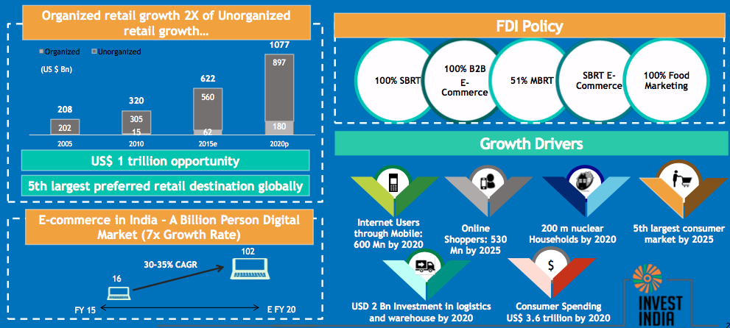
RETAIL

Slide 56
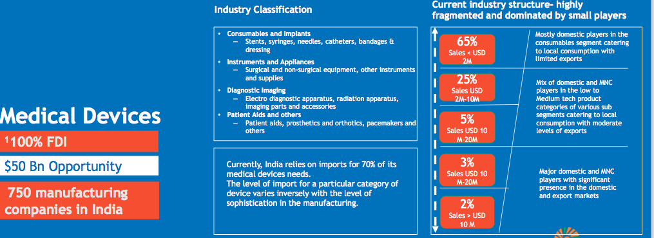
MEDICAL DEVICES

Slide 57
Potential Sectors: Medical Devices
Medical devices industry of India: Opportunities for US SMB’s
Macroeconomic factors suggest a huge potential for double-digit growth in the Indian medical device sector.
Upcoming developments in the regulatory and policy framework are expected to accelerate growth of the Indian medical devices sector at an estimated 10-year CAGR of 15%.

Slide 58
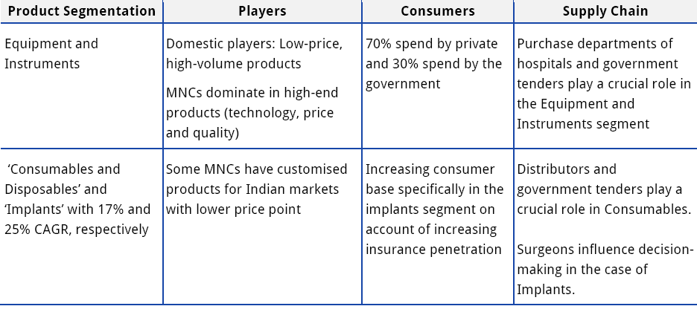
Potential Sectors: Medical Devices
Overview of India’s medical devices industry

Slide 59
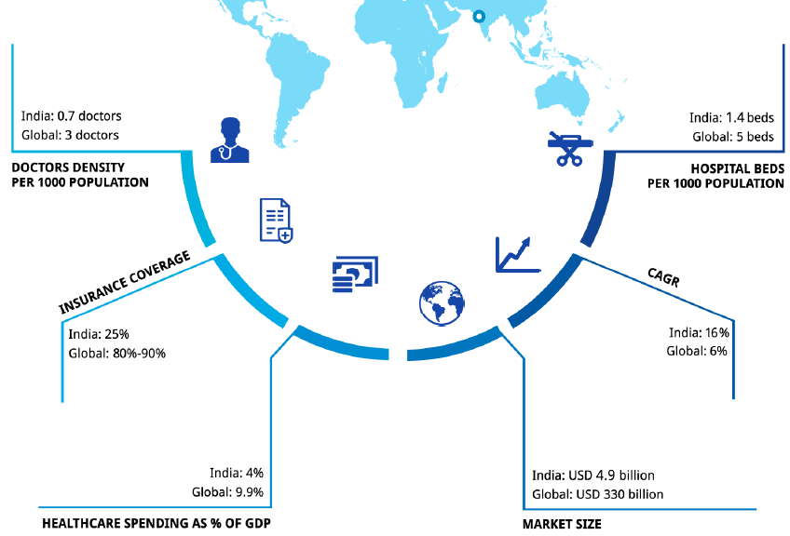
Potential Sectors: Medical Devices
Growth drivers of India’s medical devices industry

Slide 60
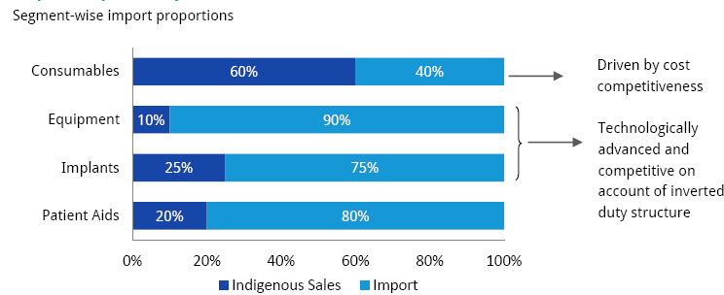
Potential sectors: Medical devices
Overview of current imports in India’s medical devices industry:
Huge opportunities for US SMB’s
Market sizes in brackets
(USD 1.31 billion)
(USD 2.67 billion)
(USD 0.35 billion)
(USD 0.65 billion)
The Indian medical device sector is characterized by import dependency and a highly fragmented domestic industry.
Presently, imports are preferred over domestic manufacturing mainly due to the inverted duty structure and the lack of favorable policy and regulatory framework.

Slide 61
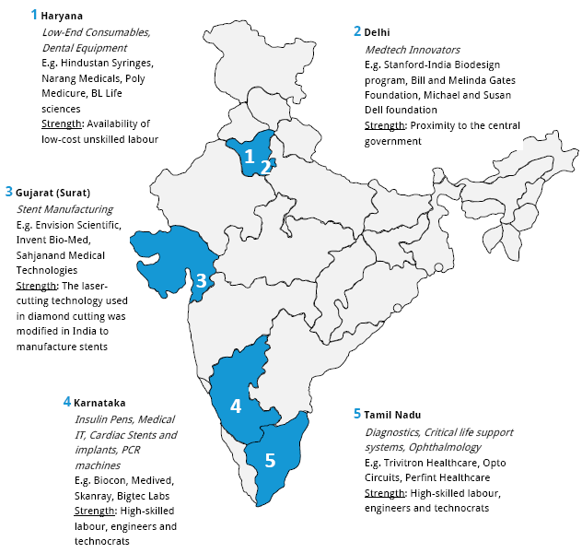
Potential Sectors: Medical Devices
Medical device clusters of India

Slide 62
Potential Sectors: Medical Devices
Success stories in India’s medical devices industry

Slide 63
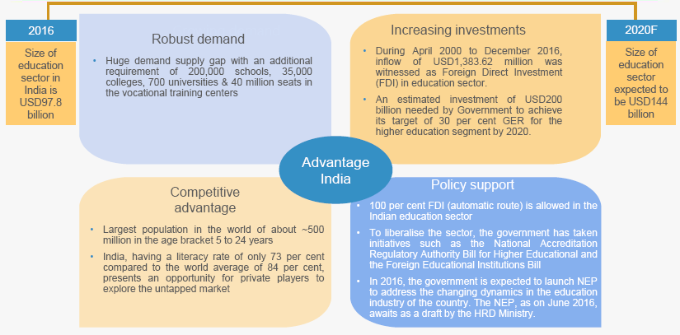
Potential Sectors: Education and Training

Slide 64
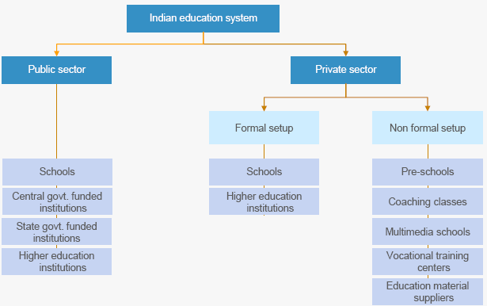
Potential Sectors: Education and Training
Education and training landscape of India

Slide 65
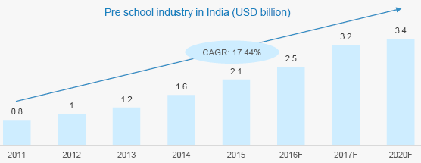
Potential Sectors: Education and Training
Notable trends in India’s education sector - Preschools
In the year 2015 the Pre-school segment was worth $2.1 billion, of which branded Pre-school segment was expected to contribute 33.83 % to the total Pre-school industry in India.
Pre-school segment in India is expected to grow from $0.75 billion in 2011 to $3.4 billion by 2020, exhibiting growth at a CAGR of over 17 %.
With growing awareness among tier 2 & tier 3 cities, penetration rate for the pre school segment is expected to rise to 25 % in 2015. To ensure scalability, preschool chains like Kidzee, Eurokids are upgrading to K-12 schools.
Government of Jammu & Kashmir, stressed on the need for strengthening the integrated school system and making more dynamic investment at primary level, to improve quality of education in the Government-run educational institutions.

Slide 66
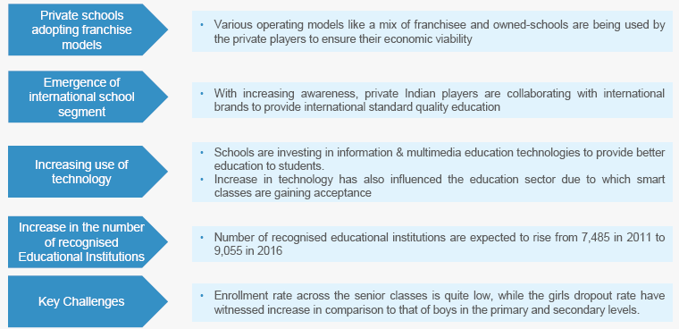
Potential Sectors: Education and Training
Notable trends in India’s education sector – K-12

Slide 67
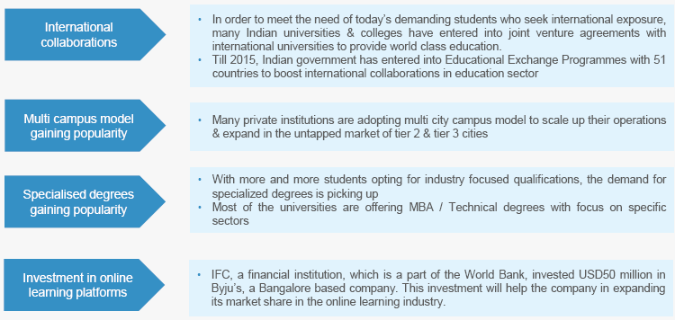
Potential Sectors: Education and Training
Notable trends in India’s education sector – Higher education

Slide 68
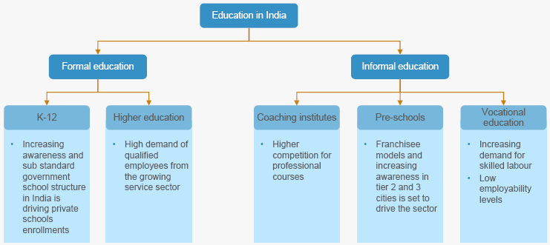
Potential Sectors: Education and Training
Increasing disposable income and willingness of people to spend on education is a key driver for the Indian education industry

Slide 69
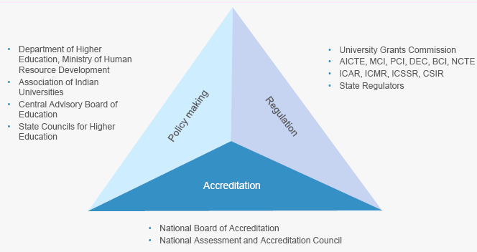
Potential Sectors: Education and Training
Regulatory framework of higher education in India

Slide 70
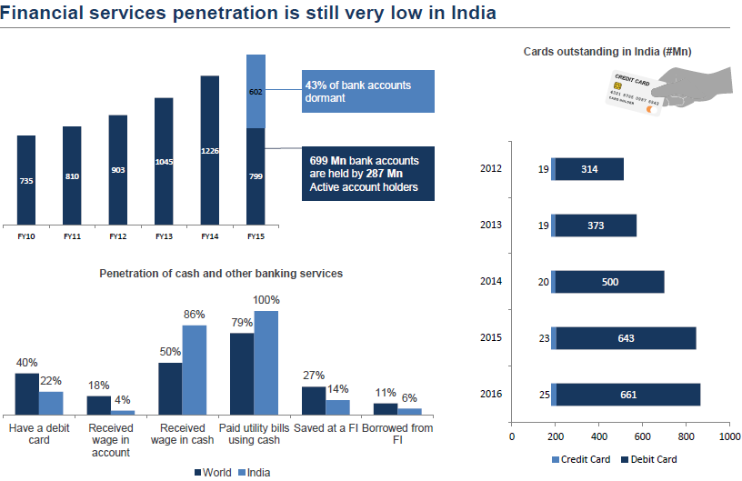
Potential Sectors: FinTech

Slide 71
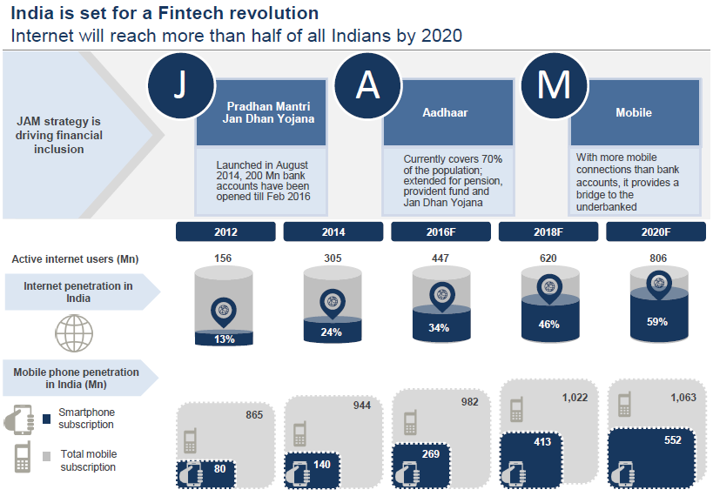
Potential Sectors: FinTech

Slide 72
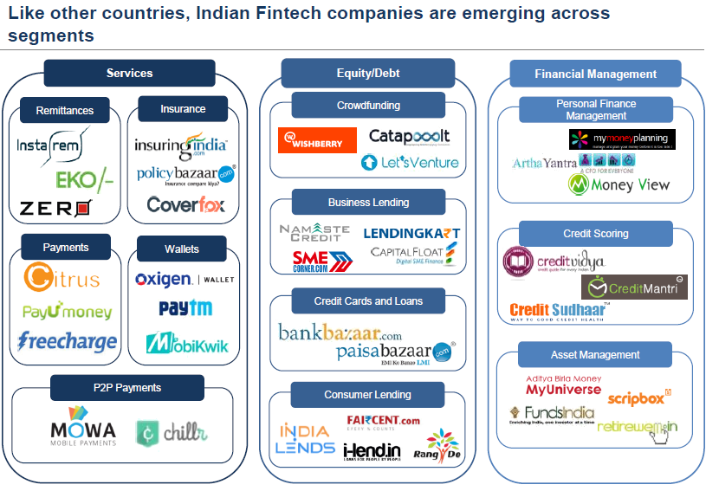
Potential Sectors: FinTech

Slide 73
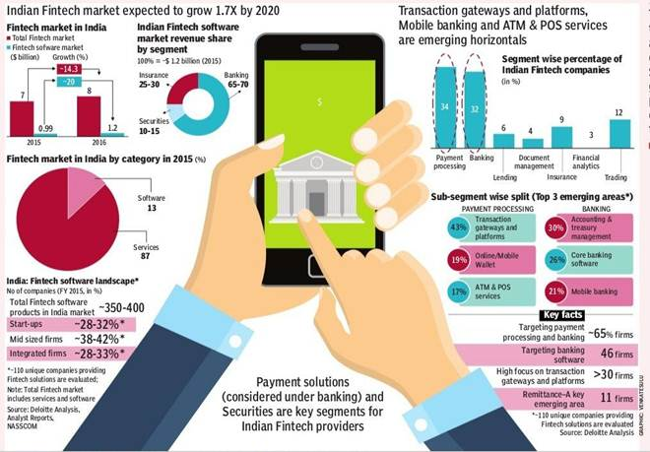
Potential Sectors: FinTech

Slide 74
Potential Sectors: CleanTech
Cleantech opportunities in India
Major RE Technology in India | FY 2015 – 16 Capacity Addition | Cumulative status (As on 31st Jan 2016)
Wind Energy | 1,744 MW | 25,188 MW
Solar Energy | 1,489 MW | 5248 MW
Small Hydro Power | 132 MW | 4187 MW
Bio-Power (Biomass & Gasification and Bagasse Cogeneration) | 342 MW | 4760 MW
Waste to Power | 12 MW | 127 MW
Wind power generation potential in India is 300,000 MW.
Solar power capacity targets are at 100,000 MW by 2022, entailing an investment of $93 billion, to make India one of the largest green energy producers.

Slide 75
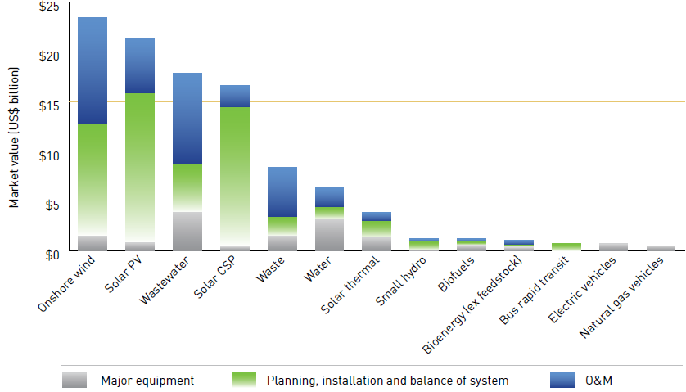
Potential Sectors: CleanTech
Clean technology market opportunity analysis shows that as much as $103 billion will be invested across 13 clean technology sectors in India over the next decade.
Size of the clean technology market accessible to SMEs in India
($ billion)

Slide 76
Potential Sectors: CleanTech
Cleantech opportunities in India
Leading opportunities for SMEs in India are in onshore wind (about $23 billion), solar PV (about $21 billion), and wastewater (about $18 billion).
With some of the other key opportunities being in:
Energy Efficiency
Smart Grids
Green Buildings
Environment Technologies
Waste management, development of urban areas, water & sanitation
Clean Coal Technologies
Coal beneficiation, Coal combustion, Coal conversion
Water Management
Industrial waste water management , Drinking water purification

Slide 77
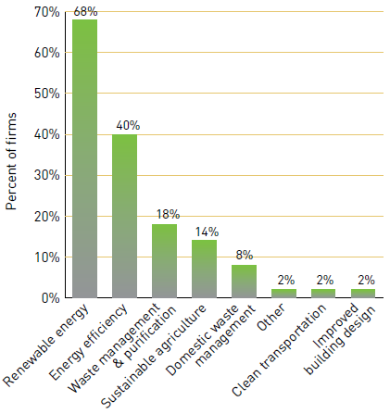
Potential Sectors: CleanTech
Sectors in which clean technology SMEs of India are currently involved

Slide 78
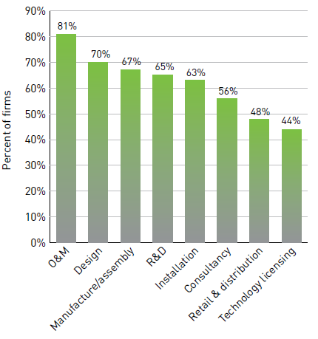
Potential sectors: Cleantech
Potential Sectors: CleanTech
Activities in which clean technology firms of India are involved

Slide 79
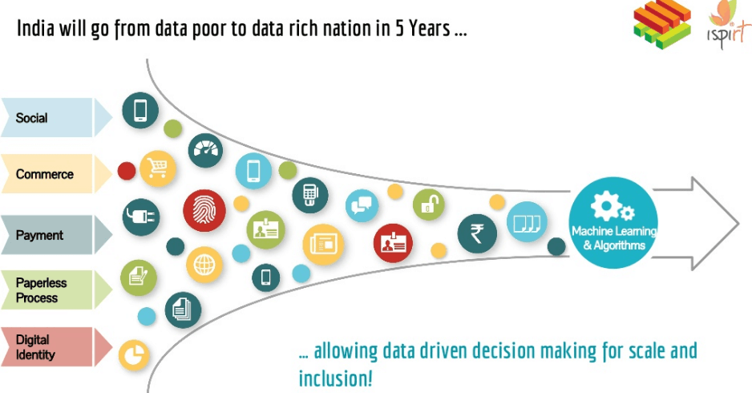
Potential Sectors: Digital Tech
The digital transformation that is washing across the global economy is also breaking against India’s shores. Many Indian companies are eager to adopt digital technology into their business models, while consumers are moving online in increasing numbers.
Pace of transformation across industries in India is not uniform, and at times contrasts that of global peers in the same sector. In some sectors, like financial services, domestic companies are embracing the changes and their response is on par to that of their global peers.
Other industries, like healthcare and manufacturing, have been slower to adopt the new technology than the global trend. For both types, the continued shift towards digital technologies is inevitable and companies moving faster will enjoy competitive advantages.

Slide 80
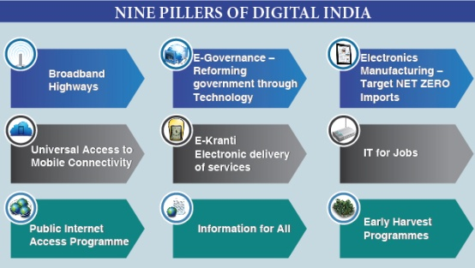
Potential Sectors: Digital Tech
India’s move towards the digital opportunity is also helped by government efforts. “Digital India” focuses on expanding digital infrastructure, improving the delivery of government services, and empowering citizens through improved access. → Government departments have committed more than $ 16 billion to the program.
US technology and business services companies targeting this opportunity will have to understand how the market and their clients are changing. For example, heads of business units and functions are becoming much more involved in technology decisions, customers are looking for simplified products and services, and many companies are struggling to employ competent IT talent.

Slide 81
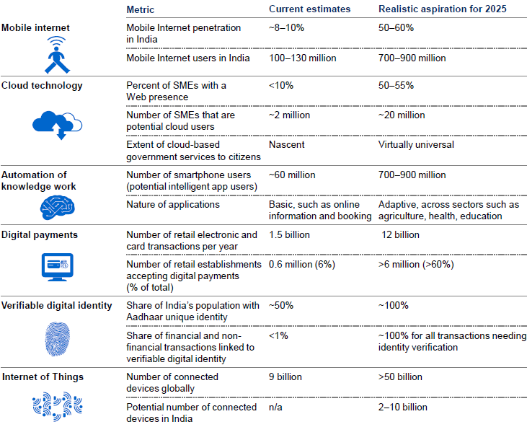
Potential Sectors: Digital Tech
Potential adoption of 12 empowering technologies in India: Opportunities for US companies

Slide 82
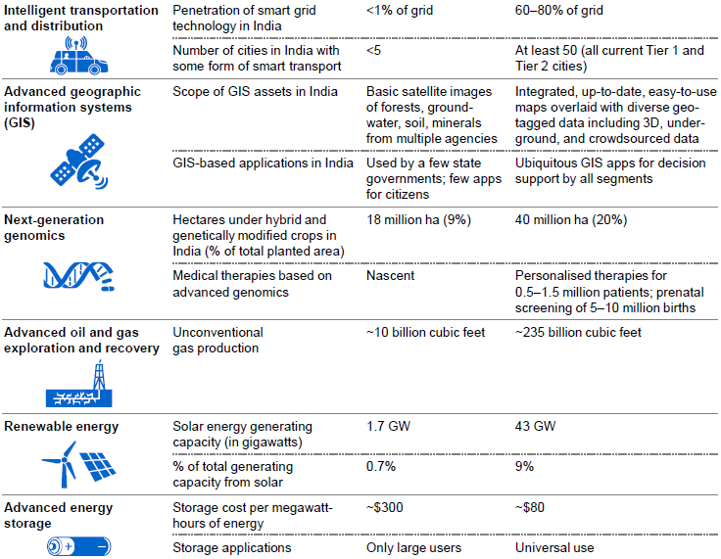
Potential Sectors: Digital Tech
Potential adoption of 12 empowering technologies in India: Opportunities for US companies

Slide 83
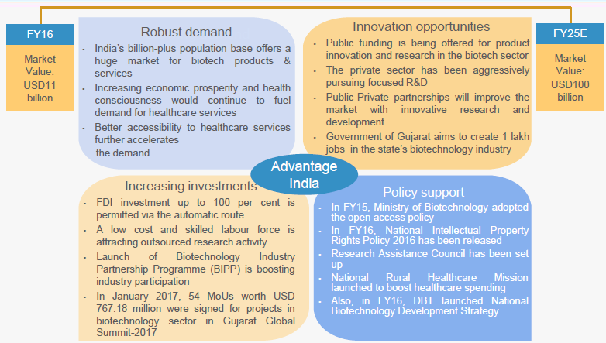
Potential Sectors: BioTech

Slide 84
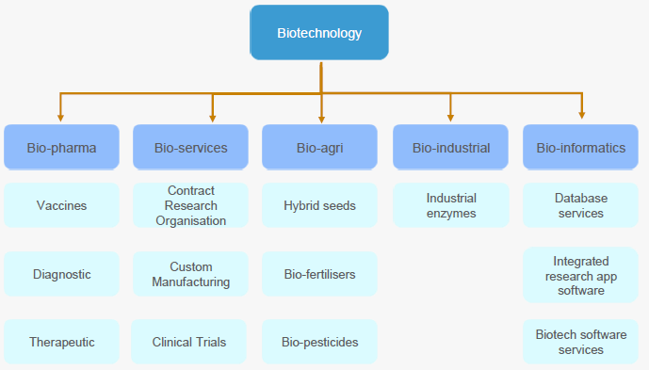
Potential Sectors: BioTech
Major products/services of India’s biotechnology industry

Slide 85
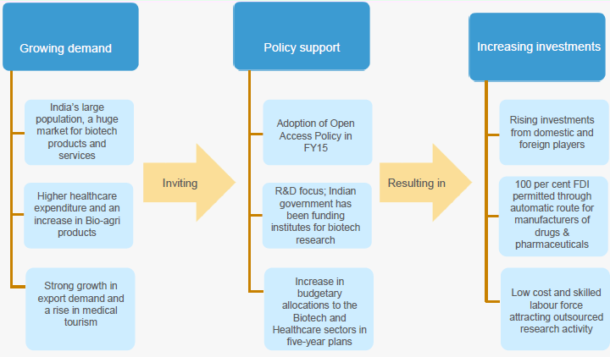
Potential Sectors: BioTech
Biotech benefits from rising income and population of India

Slide 86
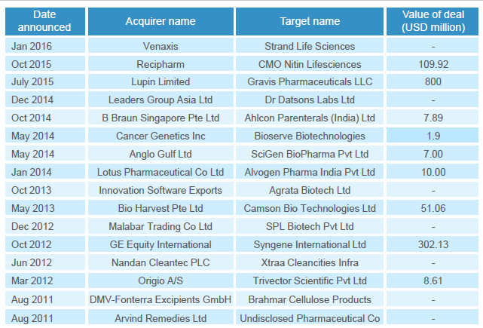
Potential Sectors: BioTech
Strong inflow of foreign investment

Slide 87
Potential Sectors: BioTech
Huge opportunities for innovation in agriculture/healthcare segments of biotech

Slide 88
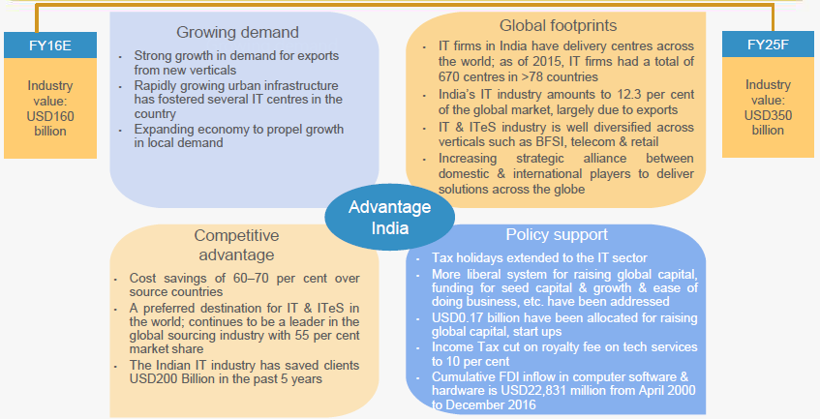
Potential Sectors: Information Technology

Slide 89
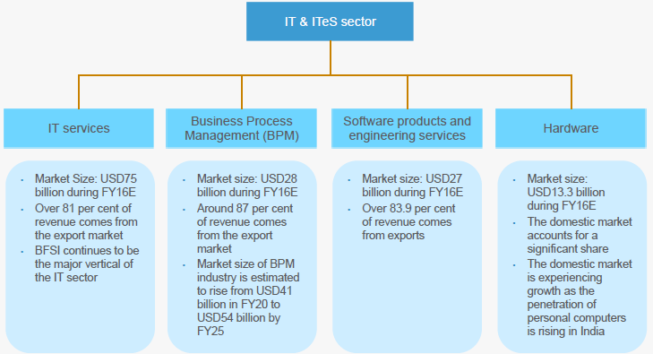
Potential Sectors: Information Technology
Segments of India’s IT sector

Slide 90
Potential Sectors: Information Technology
Notable trends in India’s IT sector

Slide 91
Potential Sectors: Information Technology
Notable trends in India’s IT sector

Slide 92
Potential Sectors: Information Technology
Notable trends in India’s IT sector

Slide 93
Potential Sectors: Information Technology
Prospects for US SME’s: Newer geographies and verticals provide huge opportunities from India

Slide 94
Potential Sectors: Information Technology
Prospects for US SME’s: Start-ups are driving innovation across India’s IT sector

Slide 95
Potential Sectors: Health Care

Slide 96
Potential Sectors: Health Care
India’s healthcare market functions through five segments

Slide 97
Potential Sectors: Health Care
India’s healthcare sector growth trend (In US$ billion)
Healthcare has become one of India's largest sectors both in terms of revenue and employment.
The industry is growing at a tremendous pace owing to its strengthening coverage, services and increasing expenditure by public as well private players.
The total industry size is expected to touch $160 billion by 2017 and $280 billion by 2020
As per the Ministry of Health, development of 50 technologies is being targeted for the treatment of diseases like Cancer and TB.
Government is emphasising on the eHealth initiatives such as Mother and Child Tracking System (MCTS) and Facilitation Centre (MCTFC).
Indian companies are entering into merger and acquisitions with domestic and foreign companies to drive growth and gain new markets.

Slide 98
Potential Sectors: Health Care
Notable trends in India’s healthcare sector

Slide 99
Potential Sectors: Health Care
Notable trends in India’s healthcare sector

Slide 100
Potential Sectors: Health Care
India’s healthcare sector is attracting lucrative M&A deals
Pharma, healthcare and biotech have witnessed significant increases in M&A activities over the years; over the last three years, pharmaceuticals segment has accounted for more than 70% of M&A deals in India.

Slide 101
Potential Sectors: Health Care
India’s healthcare sector is a hot spot for PE investors

Slide 102
Potential Sectors: Health Care
Opportunities for US SMB’s in India’s healthcare sector

Slide 103
Potential Sectors: Health Care
Opportunities for US SMB’s in India’s healthcare sector
Huge scope for enhancing healthcare services considering that healthcare spending as a percentage of GDP.
Rural India, which accounts for over 70 % of population and is set to emerge as a potential demand source.
Only 3 % of specialist physicians cater to rural demand.
Vast opportunities for investment in healthcare infrastructure in both urban and rural India.
About 1.8 million beds required by the end of 2025.
Additional 1.54 million doctors and 2.4 million nurses required to meet the growing demand.

Slide 104
Clean India (Swachh Bharat)
Digital India
Skill India
Smart India
Start Up India
Stand up India
Ease of Doing Business
Products
Projects
Products / technology
Ease of doing business
Projects
Products
People
Jobs

Slide 105
Time for QUESTIONS…

Slide 106
Our philosophy : Action @ Speed of thought Follow Mentor on road at: www.mentoronroad.com/usa Facebook page: globaljagat Twitter: globaljagat Linkedin: /in/clusterpulse Handphone : India - +91-9825506441 USA - +1 928 306 5335 jagat@globaljagat.com
Any questions

